Slide 1

My vote – voting system
By-
Mona Supriya (46283010)
Omni Gupta (46283152)
Ruchi Kumari (46283149)
Snehlata Verma (46283119)
Sucharita Behera (46289245)

Slide 2
CONTENTS
Objective
Introduction
Technology
Context Diagram
Flow Chart
Data Flow Diagram
Snapshots

Slide 3
Objective
To create My Vote system for the admin so that voting process goes smoothly, and users can vote. Users can nominate themselves as well as vote for the candidates.
The application is to be developed as executable file, compiled on Linux. So, there are 2 entities - Admin and User.

Slide 4

INTRODUCTION
My Voting is a voting system that will help in managing elections. This voting system can be used for nominating candidates, casting votes and displaying poll results during the elections. There is a database which is maintained in different files in which contains all the name of the candidates and voters with their username and password.

Slide 5

Technology
Languages – C
Operating System – Linux

Slide 6
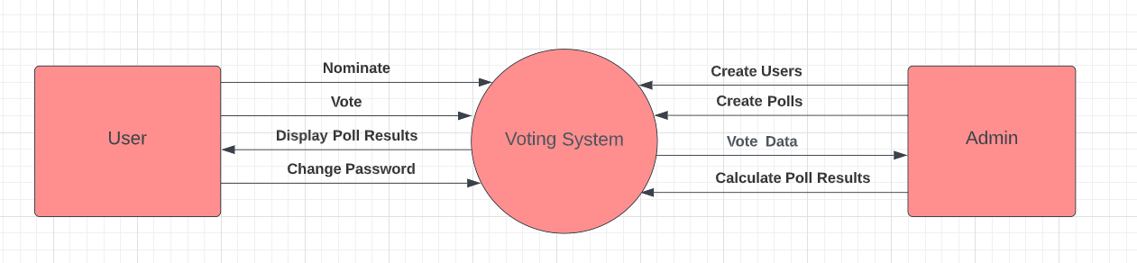
Context Diagram

Slide 7
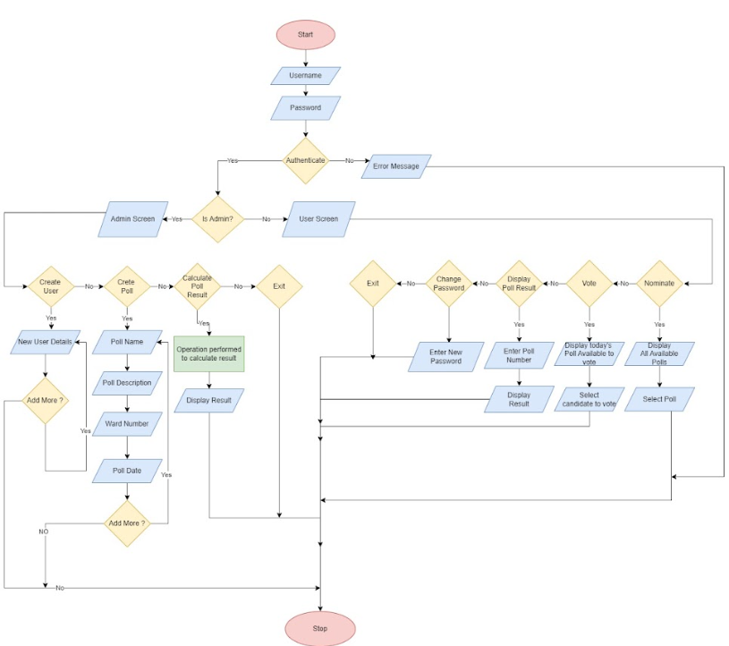
Flow Chart

Slide 8
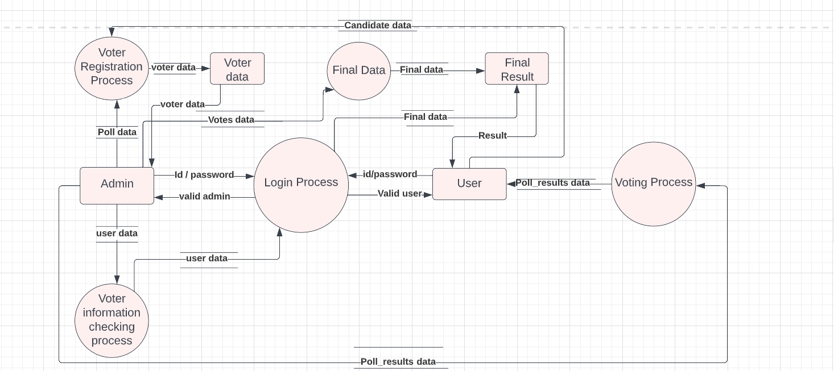
Data Flow Diagram

Slide 9
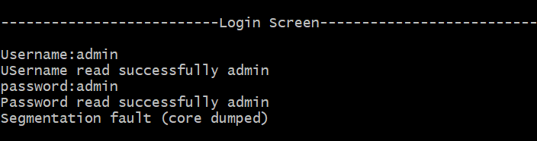
Implementation

Slide 10
Thank you

